Slide 1
CPE 301 Project Presentation
Elizabeth Heider
heider@unlv.nevada.edu
Adrian Ruiz
ruiza12@unlv.nevada.edu

Slide 2
AIM & ACCOMPLISHMENT
AIM:
Our goal of this project was to construct a remote controlled robot using the Atmega328P microcontroller.
ACCOMPLISHMENT
We programmed the DC motor robot to run wireless through Wifi using a NodeMCU and an App downloaded on our phones as the controller.

Slide 3
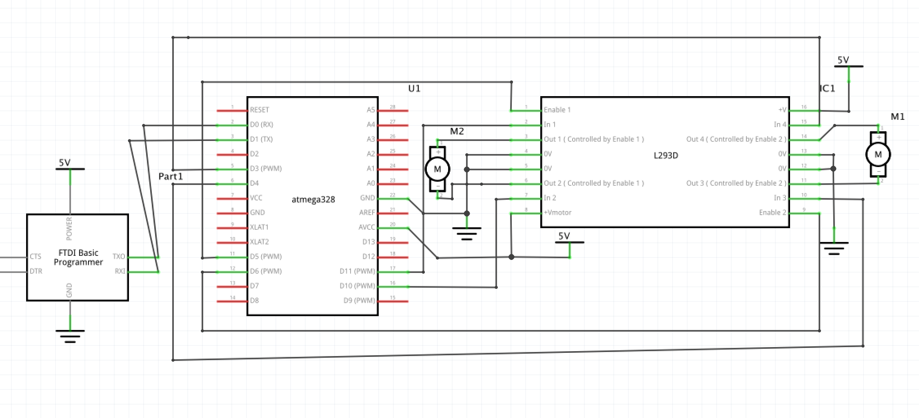
SCHEMATICS
3.3V
NodeMCU

Slide 4
DESIGN STAGES
Components
AVR ATMEGA328p Xplained Mini
L293D IC
NodeMCU
iPhone – Blynk App Joystick (as controller)
Interfaces
Atmega328p – NodeMCU- USART

Slide 5
CODE DEVELOPMENT (Initialization)
Initialize Motor Control Function
USART Initialization
Add Header Files
Loop Forever

Slide 6
CODE DEVELOPMENT
PWM Control on Motors
USART Transmit
Arduino Program on NodeMCU
Main function
Run Control Loop

Slide 7
DEMO SNAPSHOT/VIDEO
https://www.youtube.com/watch?v=dYUO4AFEpqo&authuser=1

Slide 8
Group Projects
Student Name: Elizabeth Heider
Task Completed: Motor Programming/Wiring, Debugging Issues
Contribution % towards the project: 50%
Coding (%): 50%
Implementation (%): 50%
Testing/Demo (%): 50%
Documentation (%): 60%
Presentation (%): 60%

Slide 9
Group Projects
Student Name: Adrian Ruiz
Task Completed: Interfacing DC motor control with “Blynk” application in AVR Code.
Contribution % towards the project: 50%
Coding (%): 50%
Implementation (%): 50%
Testing/Demo (%): 50%
Documentation (%): 40%
Presentation (%): 40%

